Slide 1
BEST TIME TO BOOK HOTEL
CAPSTONE PROJECT
Presented By:
M NANDHABALAN – UCEK – UNIVERSITY COLLEGE OF ENGINEERING KANCHIPURAM – B.E MECHANICAL ENGINEERING

Slide 2
OUTLINE
Problem Statement
Proposed System/Solution
System Development Approach
Algorithm & Deployment
Result
Conclusion
Future Scope
References

Slide 3
Problem Statement
The project intension is to find out optimum time and best hotels around the year.
Using the project to make prediction on the crowd around the hotel will be an valuable information for both hotel owners and customer'

Slide 4
Proposed Solution
According to the average daily rate in both the hotels, january is the month when people do not go to the hotel that month is the right month to book the hotel.
According to the charting the highest occupancy happens in the month of august and people also go in that month,nearly 8000 count. january is the best month to go without any hassle. nearly below 2000 people go, so that is the best month.
Most of the cancellations happen in both the hotels in the month of august and may. january is the best month to go without any hesitation

Slide 5
System Approach
Building the proposed solution requires combination of data processing ,feature engineering ,data visualization
System requirements:
Hardware requirements:
Processor (CPU):
A multi-core processor is recommended, especially for handling large datasets and complex computations.
Software requirement :
An os compatable with the project to run it smooth (windows ,mac ,linux)

Slide 6
System approach
Library requirement:
Data processing and analysis:
Pandas
Data visualization:
Matplotlib , seaborn

Slide 7
Algorithm & Deployment
Data Loading: Load the hotel dataset into your Python environment.
Data Cleaning:
Handle missing values: Drop or impute missing
Data Preprocessing:
Create new features if necessary (e.g., total stays, total guests).
Encode categorical variables using one-hot encoding or label encoding.
Data Analysis:
Conduct exploratory data analysis (EDA) to understand the distribution of variables and relationships between them.
Analyze the distribution of hotels across different regions, market segments, and customer types
Visualization:
Use Seaborn and other visualization libraries to create insightful visualizations such as:
Time series plots for seasonal trends.
Bar plots for comparing the distribution of hotels across regions.
Box plots for analyzing the distribution of average daily rates.
Conclusion:
Summarize key findings and insights from the analysis.
Provide recommendations based on the analysis results (e.g., best hotels for different situations, strategies for reducing cancellations)

Slide 8
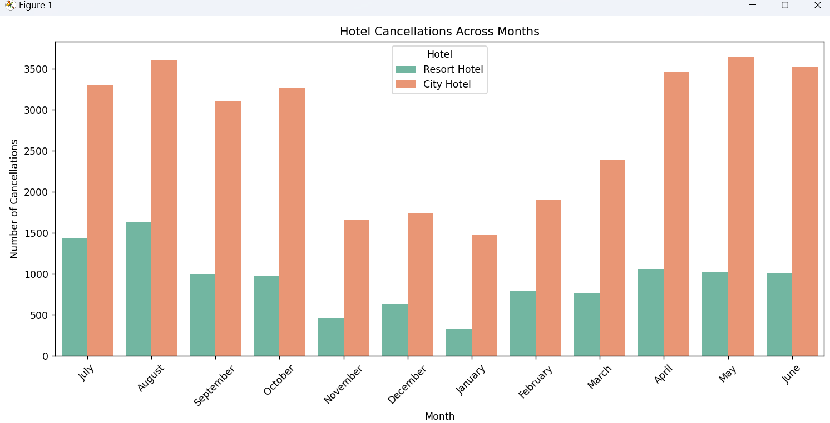
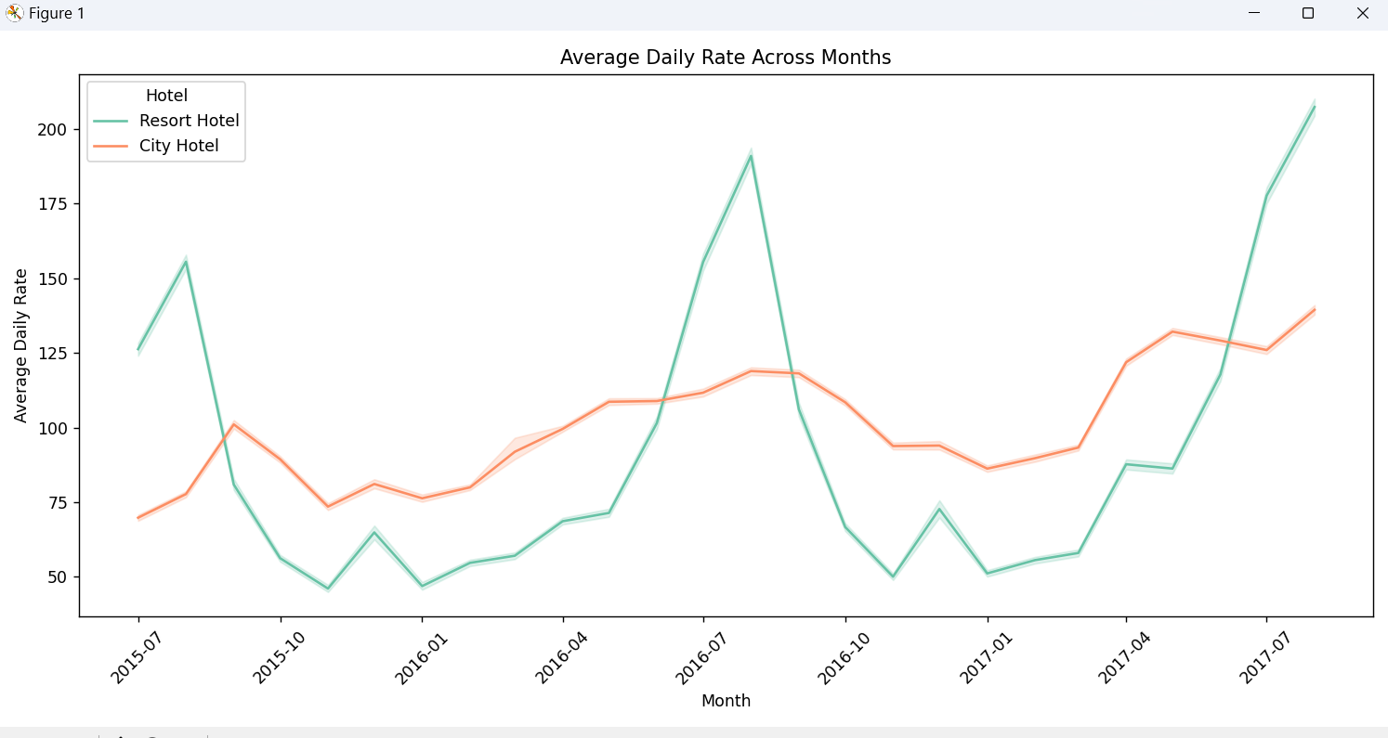
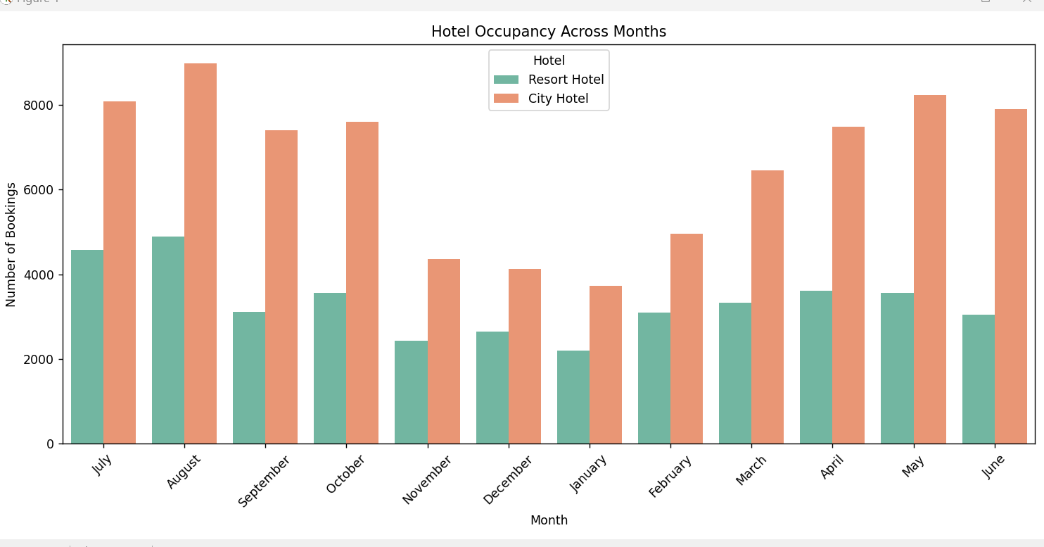
Result

Slide 9
Conclusion
The analysis reveals that hotel bookings tend to peak during the summer months (June, July, August) and decline during the winter months (December, January, February). This suggests that hotels experience higher demand during the holiday season and warmer weather.
The majority of hotels are located in popular tourist destinations such as Spain, Portugal, and the United Kingdom. This indicates that these regions attract a large number of travelers.
Based on the analysis results, hotels can implement strategies to minimize booking cancellations during peak seasons, such as offering flexible cancellation policies or targeting direct bookings through their website.

Slide 10
Future scope
Predictive Analytics:
Develop predictive models to forecast future hotel bookings based on historical data. Machine learning algorithms such as regression, time series analysis, or classification can be used to predict occupancy rates, booking cancellations, and revenue.
Personalized Recommendations:
Implement recommendation systems to provide personalized hotel recommendations to customers based on their preferences, past booking history, and demographics. Collaborative filtering or content-based filtering techniques can be employed for this purpose.

Slide 11
References
Hotel Dataset (kaggle.com)
https://youtu.be/GsfT2sv_zCo?si=qS2oDx53YumU0T4k

Slide 12
THANK YOU

